Slide 1
PROJECT REPORT
Smart Calculator
Submitted By: Submitted to:
Arnav Garg Dr. Anshu Singla
Aryan Pathania
Aryan Rathore

Slide 2
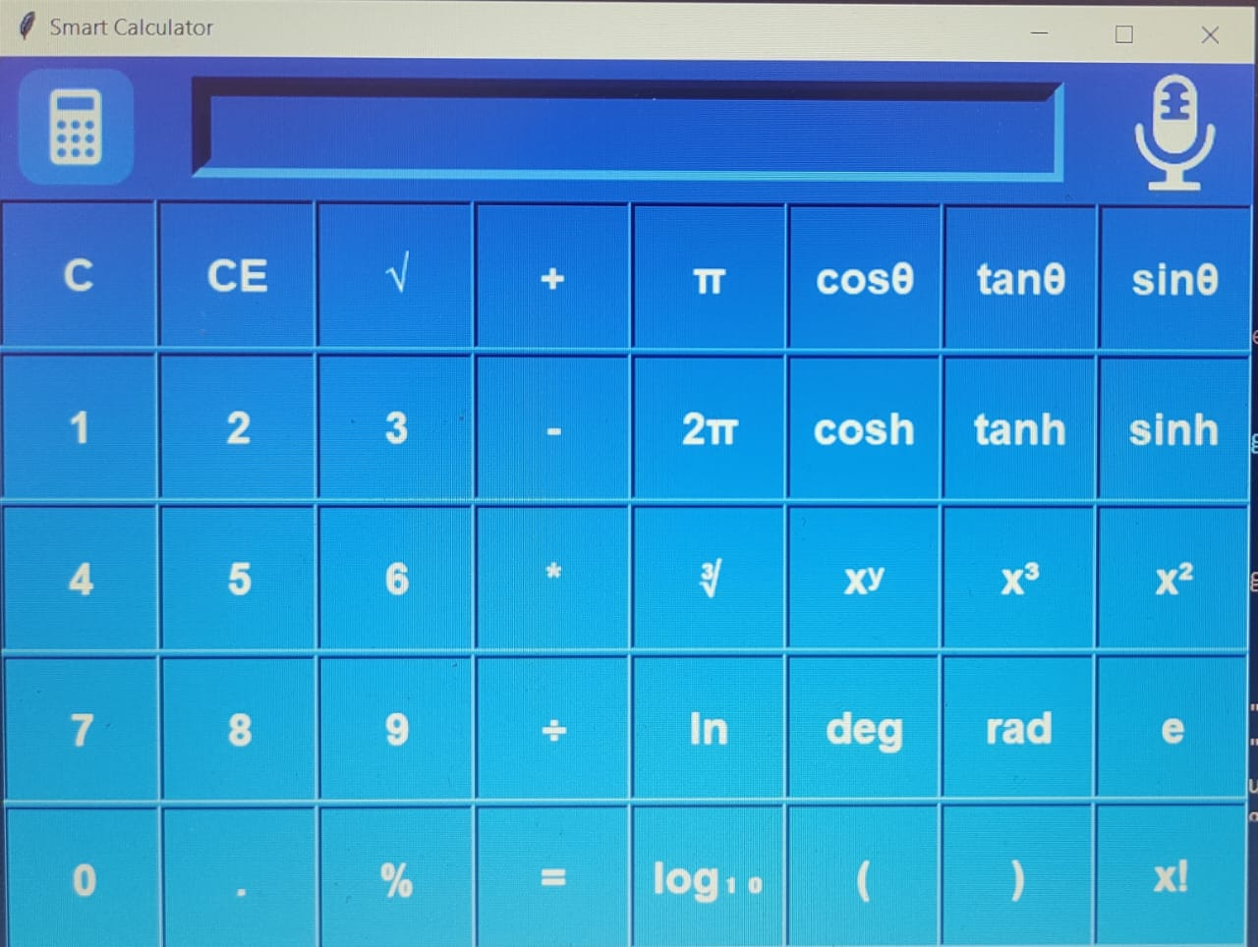

Slide 3
TABLE OF CONTENTS
1. Introduction
2.Basic function
3.proposed system
Description
System requirements
4. System design
5. Source code
6. Testing
7.Error Window
8.Future scope of the project

Slide 4
INTRODUCTION
Smart Calculator :
The calculator was written by Rolf Howarth in early 1996.
A fully featured smart calculator with proper operator precedence is implemented, including trig functions and logarithm, factorial,12 levels of parenthesis, logs to base 2, bitwise logical operators, hex, octal, binary, and ASCH display.
The calculator is written in JavaScript, and you are welcome to see the JavaScript source(visible within the HTML page) for personal education purposes as long as recognize that it is copywritten and in the public domain. this calculator is now available as a part of the hummingbird, s enterprise information portal all inquiries regarding the license calculator should be directed to hummingbird ltd.

Slide 5
BASIC FUNCTIONS
Addition:
The addition(sum function) is used by clicking on the “+” button or using the command. The result of the function results in (a+b).
Subtraction:
The subtraction(minus function) is used by clicking on the “-” button or using the keyboard. The function result in a-b.
Multiplication:
The multiplication(times function) is used by clicking on the “*” button or using the keyboard. The function results in a*b.
Division:
The division (divide function) is used by clicking on the “/” button or using the keyboard. The function results in a/b.
Sign:
The Sign key(negative key) is used by clicking on the “(-)” button. the function results in (-1)*x.
Square:
The square function is used by clicking on the “x^2” button or type “^2”. the function results in x*x.

Slide 6
Square root:
The square root function is used by clicking on the “x” button or typing “sqrt()”.this function represents x^.5 where the result squared is equal to x.
Raise to power:
The Raise to the power (y raised to x function) is used by clicking on the “y^x” button or typing”^”
Natural exponential:
The natural exponential (e raised to the x) is used by clicking on the “e^x” button or typing “exp()”.the result is e(2.71828….) raised to x
Logarithm:
The logarithm(LOG) is used by clicking on the “LOG” button or typing “LOG()”
Natural logarithm:
The natural algorithm(LN) is used by clicking on the “ln” button or typing “ln()”
Inverse:
Multiplication inverse (reciprocal function) is used by pressing the “1/x” button or typing “inv(“.this function is the same as x^-1 or dividing 1 by number
Exponent:
Numbers with exponents of 10 are displayed with an “e” for example 4.5e+100 or 4.5e-100. this function represents 10^x numbers that are automatically displayed in the format when the number is too large or too small for the display to enter a number in this format use the exponent key “EEX”.to do this enter mantissa (the non exponent part)then press “EEX” or type “e” and then enter the exponent.
Factorial:
The factorial function is used by clicking the “I” button or typing “I”

Slide 7
Proposed System
The following documentation is a project the “Name of the term paper allotted”. It is a detailed summary of all the drawbacks of the old system and how the new proposed system overcomes these shortcomings. The new system takes into account various factors while designing a new system. It keeps into account the Economical bandwidth available for the new system. The foremost thing that is taken care of is the Need and Requirements of the User.
DESCRIPTION Before developing software we keep the following things in mind that we can develop powerful and quality software
PROBLEM STATEMENT  Problem statement was to design a module: 
Which is user-friendly  Which will restrict the user from accessing other users’ data.  Which will help the user in viewing his data and privileges.  Which will help the administrator to handle all the changes.
FUNCTIONS TO BE PROVIDED: The system will be user-friendly and completely menu driven so that the users shall have no problem in using all options.  The system will be efficient and fast in response.  The system will be customized according to needs.

Slide 8
SYSTEM DESIGN
Then we began with the design phase of the system. System design is a solution, a “HOW TO” approach to the creation of a new system. It translates system requirements into ways by which they can be made operational. It is a translational from a user oriented document to a document oriented programmers. For that, it provides the understanding and procedural details necessary for the implementation. Here we use Flowchart to supplement the working of the new system. The system thus made should be reliable, durable and above all should have least possible maintenance costs. It should overcome all the drawbacks of the Old existing system and most Important of all meet the user requirements.

Slide 9
APPLICATIONS
In most countries, students use calculators for schoolwork. There was some initial resistance to the idea out of fear that basic arithmetic skills would suffer. There remains disagreement about the importance of the ability to perform calculations "in the head", with some curricular strictly calculator use until a certain level of proficiency has been obtained, while others concentrate more on teaching estimation techniques and problem-solving.
Research suggests that inadequate guidance in the use of calculating tools can restrict the kind of mathematical thinking that students engage in. Others have argued that calculator use can even cause core mathematical skills to atrophy, or that such use can prevent understanding of advanced algebraic concepts.
There are other concerns - for example, that a pupil could use the calculator in the wrong fashion but believe the answer because that was the result given. Teachers try to combat this by encouraging the student to make an estimate of the result manually and ensuring it roughly agrees with the calculated result.
Also, it is possible for a child to type in−1 × −1 and obtain the correct answer '1' without realizing the principle involved. In this sense, the calculator becomes a crutch rather than a learning tool, and it can slow down students in exam conditions as they check even the most trivial result on a calculator.

Slide 10
FUTURE SCOPE OF PROJECT
Our project will be able to implement in the future after making some changes and modifications as we make our project at a very low level.
So the modifications that can be done in our project are: To make it screen touch so no need to touch key buttons and one more change which can we made is to add snaps of the person who uses it.

Slide 11
TESTING
Testing is the major control measure used during software development. Its basic function is to detect errors in the software. During requirement analysis and design, the output is a document that is usually textual and not executable. After the coding phase, computer programs are available that can be executed for testing purposes. This implies that testing not only has to uncover errors introduced during coding, but also errors introduced during the previous phase. Thus the goal of testing is to uncover the requirements, design, and coding errors in the programs. The Source code declared above for the program Scientific Calculator has been tested and it has been found that the above source code is okay and correct. The program involves many types of conversions. These conversions have to be done carefully.

Slide 12
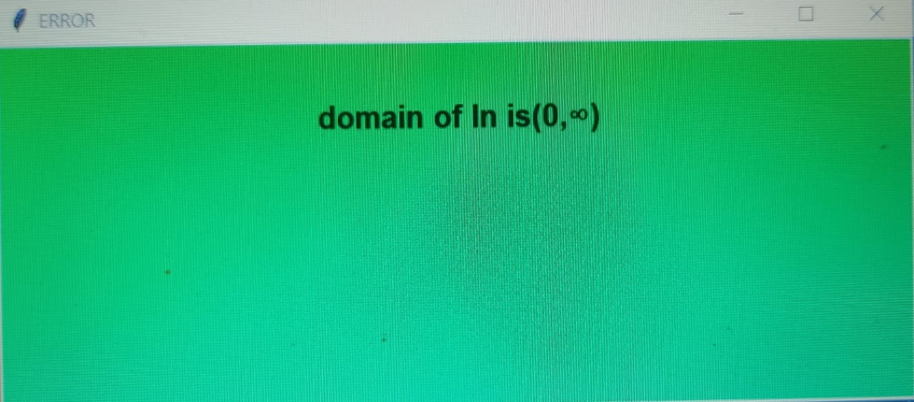
ERROR WINDOW
If We Input Value Which Will Be Out Of Domain Then Error Window Will Appear

Slide 13
REFERENCES
https://www.python.org
https://www.geeksforgeeks.org/python-gui-tkinte
https://www.w3schools.com/python
pythonalgos.com/level-1-python-scientific-calculator/
https://www.w3schools.in/python/gui-programming
GUI Programming in Python - Python Geeks

Slide 14


